Slide 1



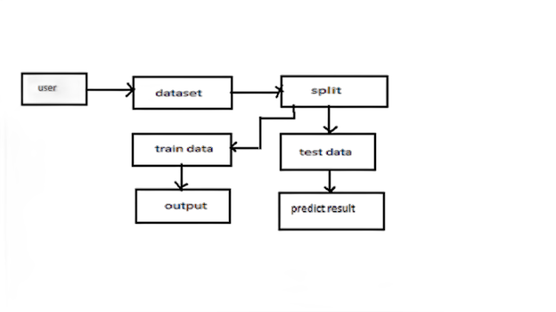
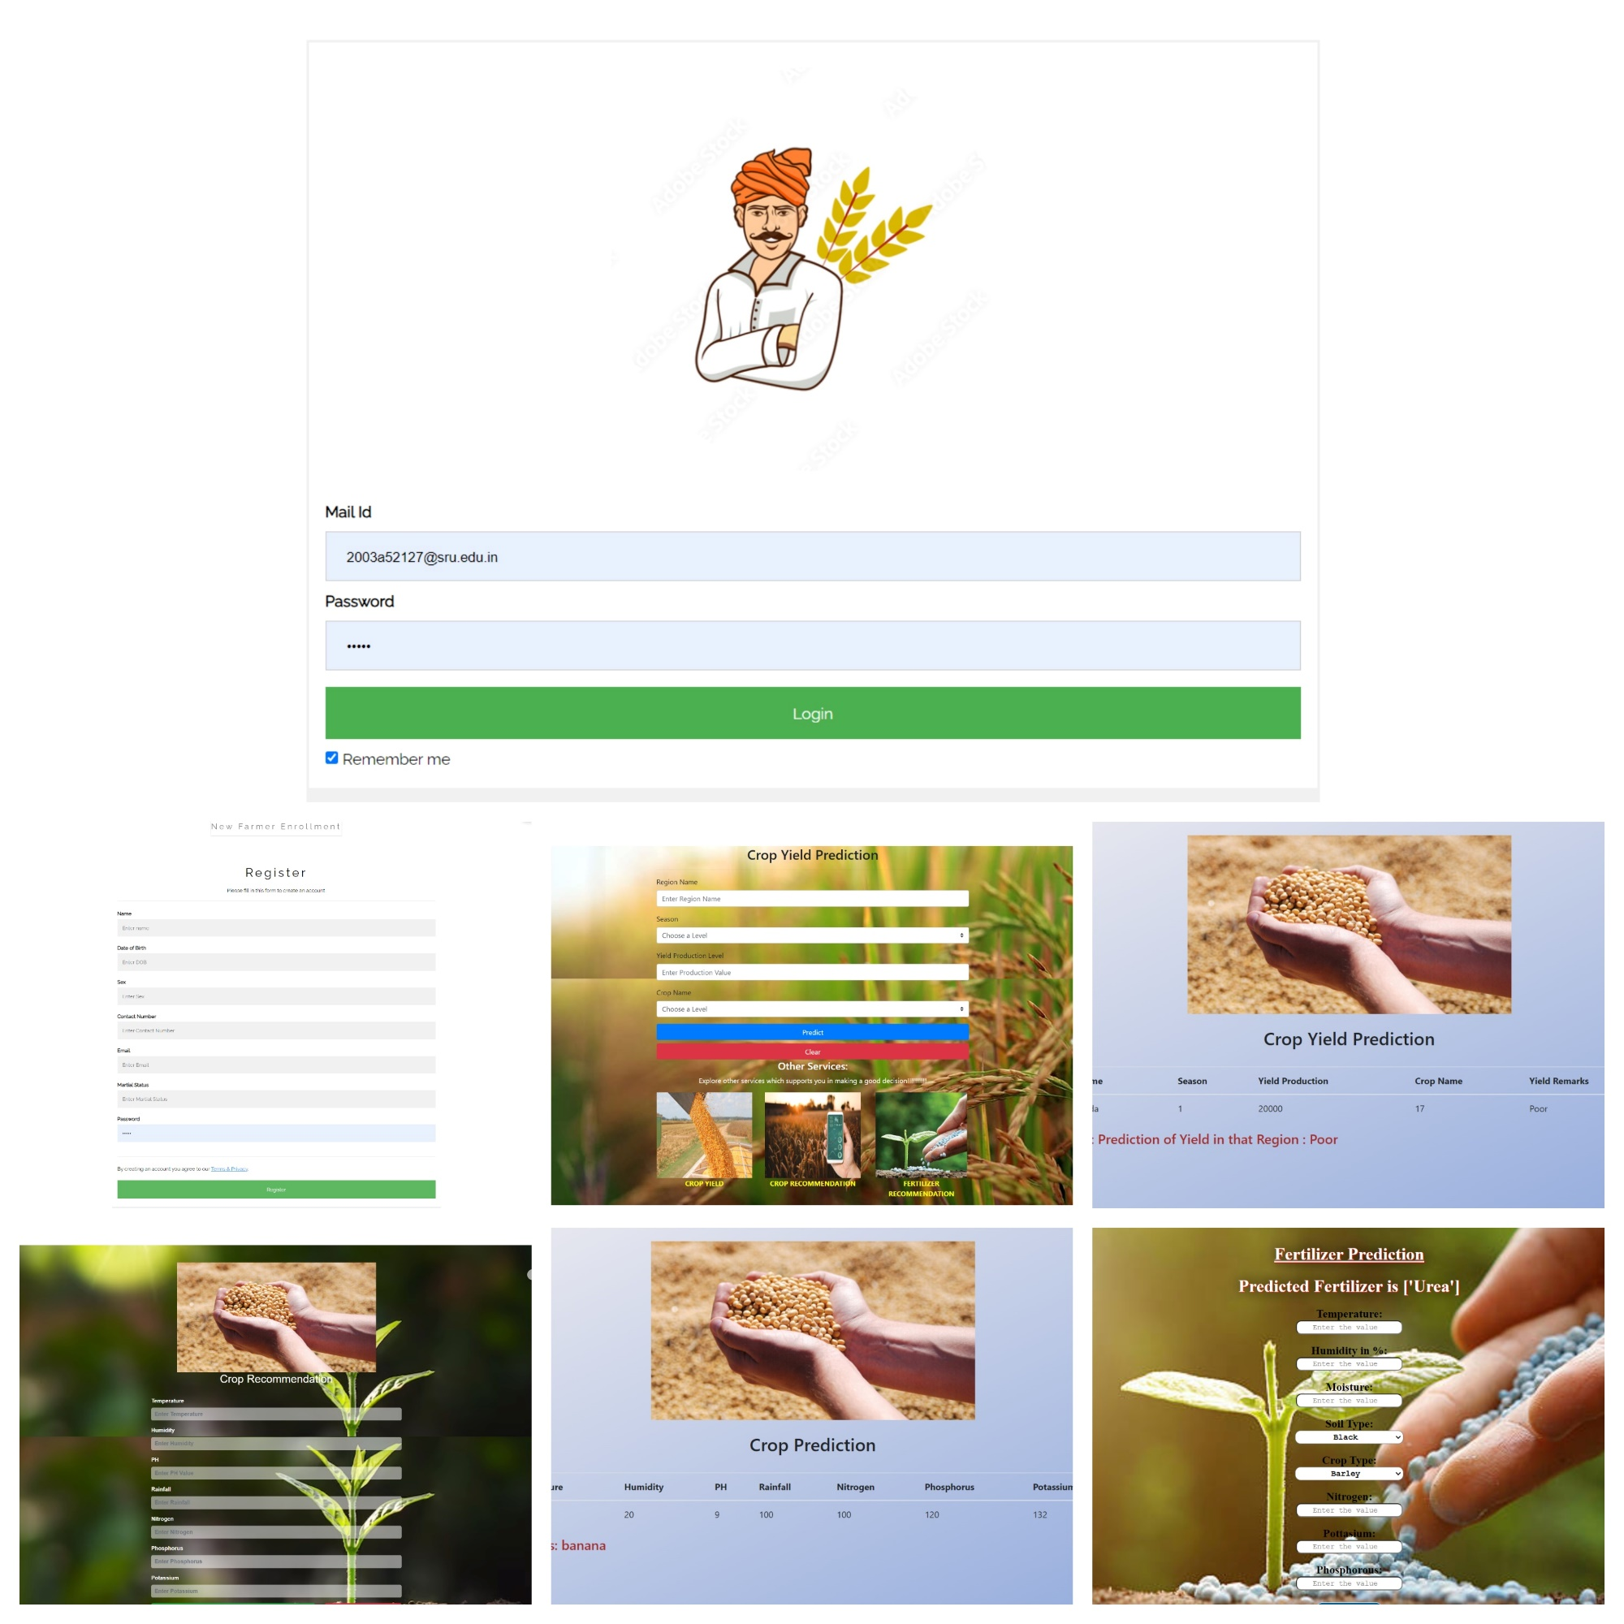
AGRICULTURE DECISION SUPPORT SYSTEM
GUIDE NAME:G.NEELIMA
2003A52127- ADUPA VIVEK, 2003A52115- NEERIPELLY VAIBHAVI, 2003A52034-KOLETI MAHALAXMI, 2003A52060- MOHAMMED SHAREEQ, 2003A52121-THUNGANI VISHNU SRI
METHODOLOGY
INTRODUCTION
The ADSS utilizes a combination of machine learning algorithms, including Random Forest, Decision Tree, K-Nearest Neighbor, and Gaussian Naive Bayes, to analyze soil content and weather parameters such as temperature, humidity, pH, and rainfall. These algorithms are trained on historical data to predict optimal crop choices and fertilizer requirements for specific farming conditions. The system provides real-time recommendations to farmers through an intuitive user interface, accessible via web or mobile platforms.
In India, agriculture serves as the backbone of the economy, yet farmers often face challenges due to traditional farming practices, leading to suboptimal crop yields and environmental degradation. To address these issues, a paradigm shift towards precision agriculture is necessary. Precision agriculture involves the use of advanced technologies and data analytics to optimize agricultural practices and improve productivity. Our research focuses on developing an Agricultural Decision Support System (ADSS) that leverages machine learning algorithms to assist farmers in making informed decisions for crop selection and fertilizer usage.
OBJECTIVES
Points | Description
Utilize Advanced Machine Learning | Develop and integrate machine learning algorithms to analyze agricultural data.
Develop Predictive Models | Develop predictive models to forecast crop yield based on environmental conditions and crop-specific requirements.
Provide Personalized Recommendations | Offer personalized recommendations for crop selection and optimal fertilizer application to maximize yield.
Provide User-Friendly Interface: | Design an intuitive user interface for farmers to easily access and utilize the ADSS recommendations.
Ensure Environmental Sustainability: | Investigate the environmental impact of precision agriculture practices promoted by the ADSS.
RESULTS
TRADITIONAL APPROACH VS. PROPOSED APPROACH
20 | Proposed Approach
Relies on anecdotal knowledge and experience. | Utilizes data-driven insights and machine learning algorithms for informed decision-making based on real-time data analysis.
Uses conventional methods without considering individual field characteristics. | Provides personalized recommendations for crop selection and optimal fertilizer application based on comprehensive analysis of soil composition and weather conditions.
Adopts a reactive approach, often resulting in crop loss. | Employs predictive analytics for proactive strategies, reducing crop vulnerability and minimizing the risk of crop damage..
Inefficient use of resources due to lack of precise monitoring and control. | Optimizes resource usage by optimizing irrigation schedules, reducing pesticide usage through targeted application, and promoting sustainable farming practices.
Limited accessibility to expert agricultural knowledge. | Offers a scalable and accessible platform for farmers to access expert recommendations and agricultural insights, empowering farmers with the tools and knowledge needed to improve their farming practices.
CONCLUSION
In conclusion, our research demonstrates the potential of the Agricultural Decision Support System to transform agricultural practices in India. By leveraging machine learning and data analytics, the ADSS offers practical solutions to address the challenges faced by farmers and enhance the overall efficiency and sustainability of agriculture. Moving forward, further research and collaboration are needed to fully realize the benefits of precision agriculture and ensure its widespread adoption across the country.

